Slide 1
2023 Convergent Capstone Design
201820925 KIM DAE MIN
201820962 KIM JONG GUK

Slide 2
Project Index
Title
Process
SWOT
Study Plan
Goal

Slide 3


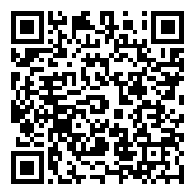

Title
Untect Order and Waiting System Using QR code

Slide 4
Process
1. Customer
- Waiting reservation and real time chatting for grasping the situation using QR code.
- Order using table QR code on web browser.
2. POS (or counter)
- Operate information that customer ordered using web POS.
- Offer real time chatting for waiting costomer.
3. Operator
- Function that check and operate data in DB on real time.
- Modify Web browser menu list.

Slide 5
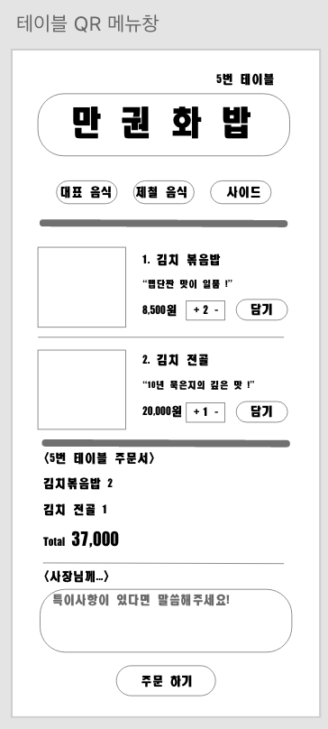
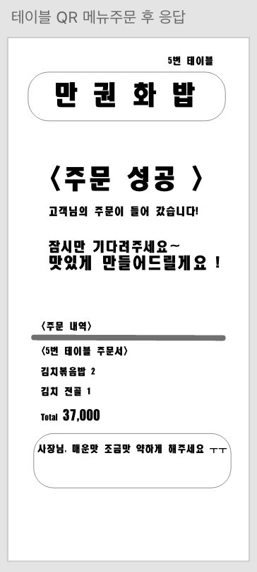
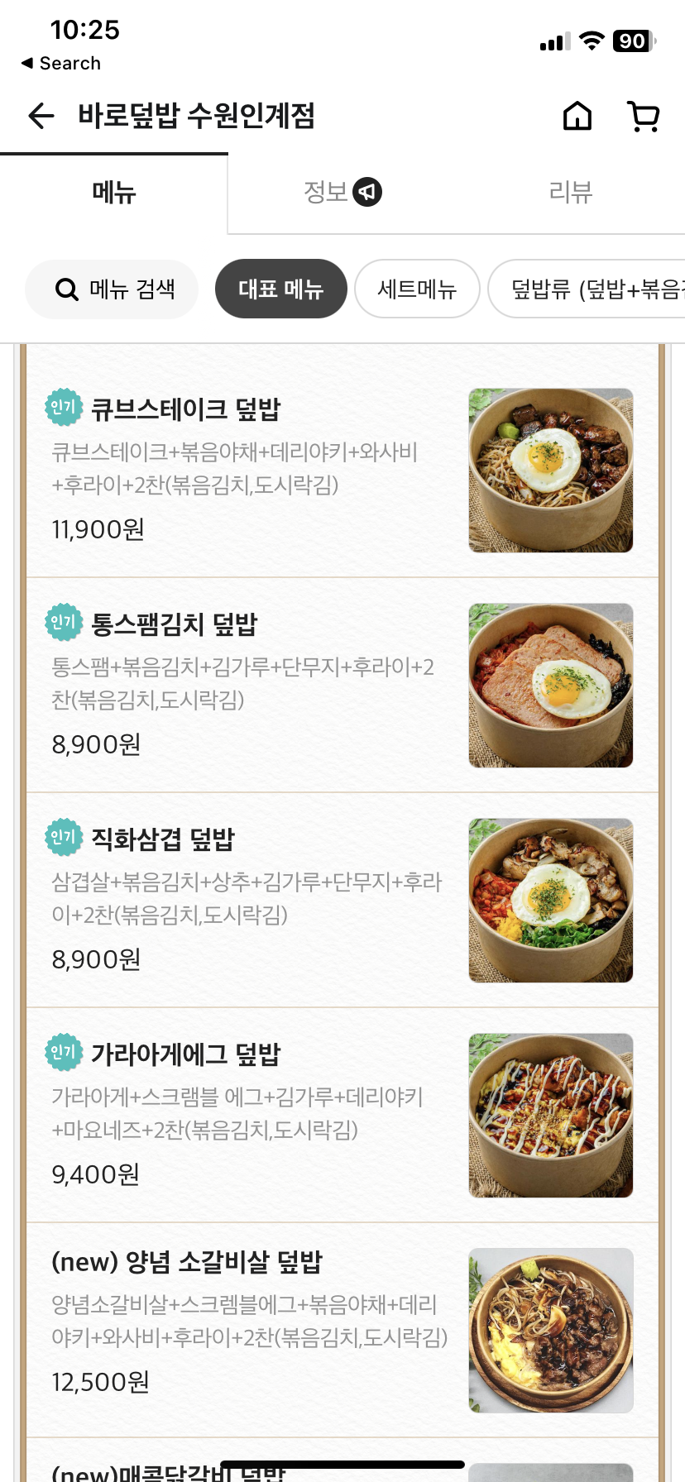


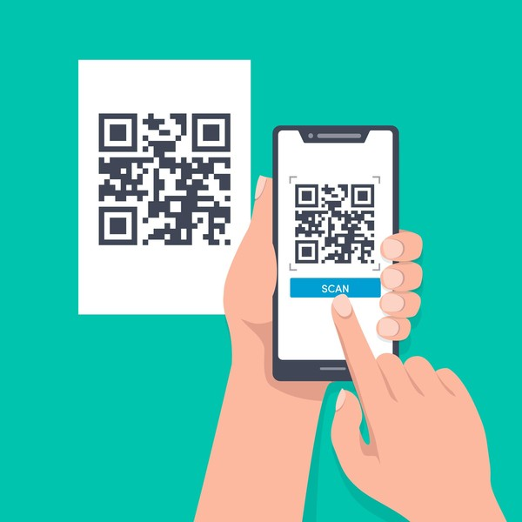
Process
POS process (order)

Slide 6
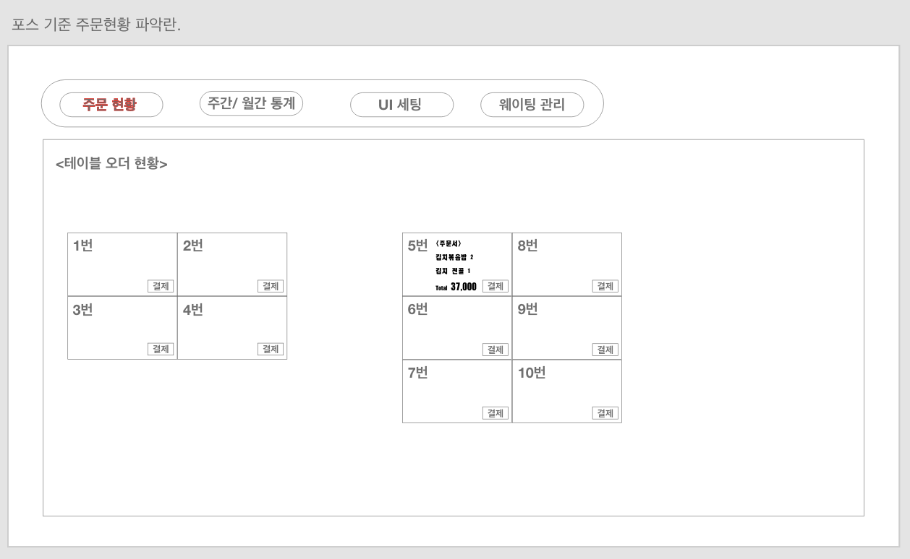
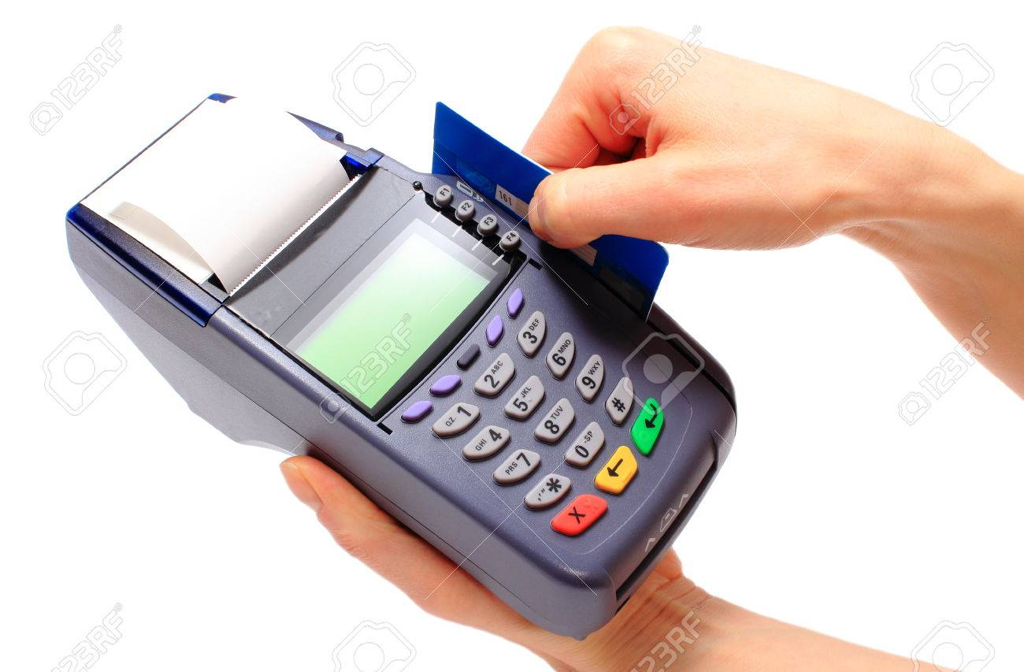
Process
POS process (account)

Slide 7
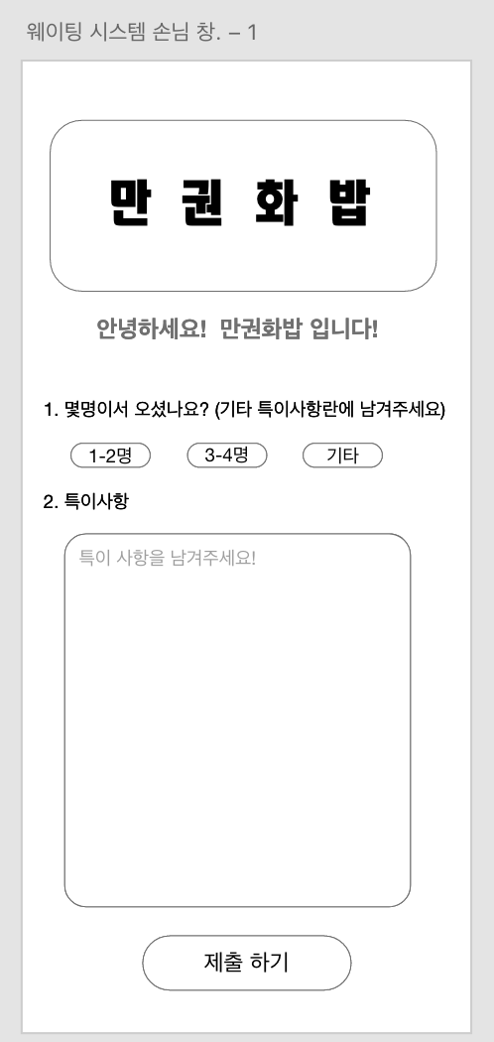
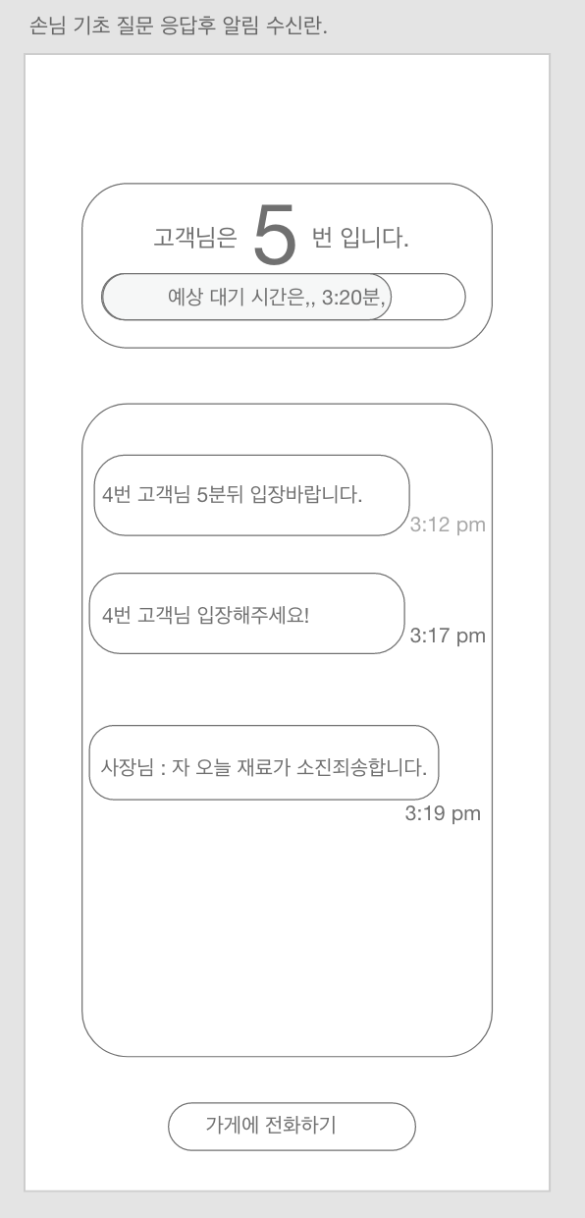
Process
Waiting Process (for Customer)

Slide 8
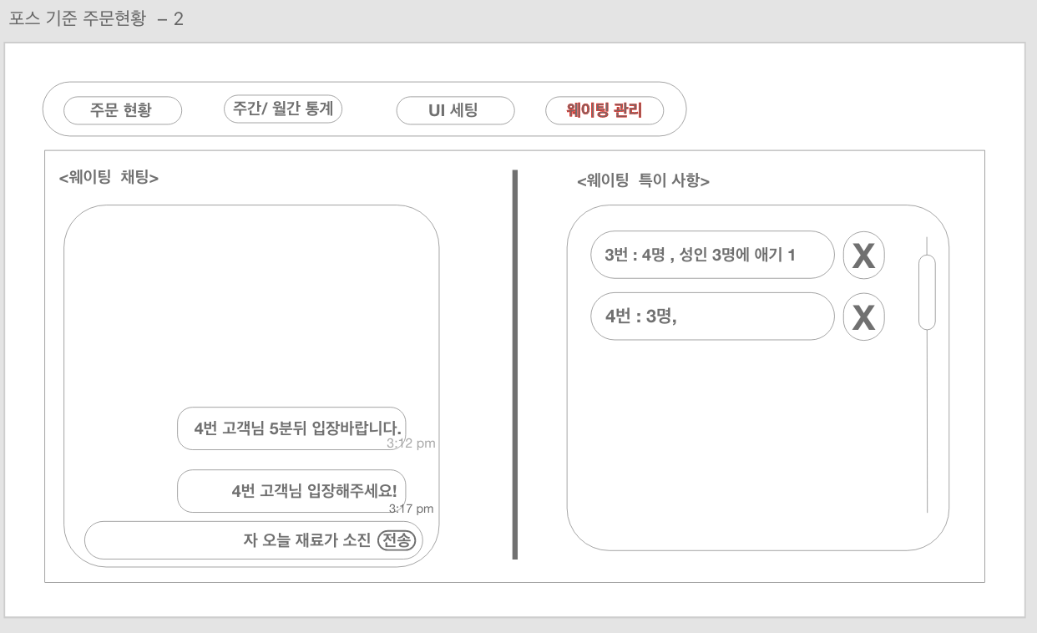
Process
Waiting Process (for POS)

Slide 9
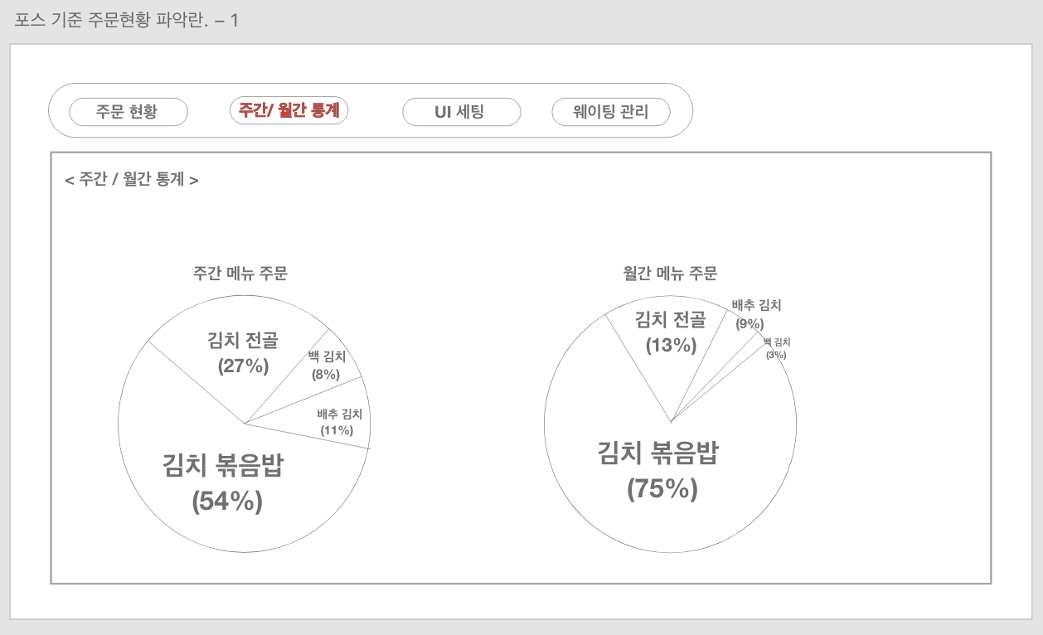

Process
Operator Process (Statistics)

Slide 10
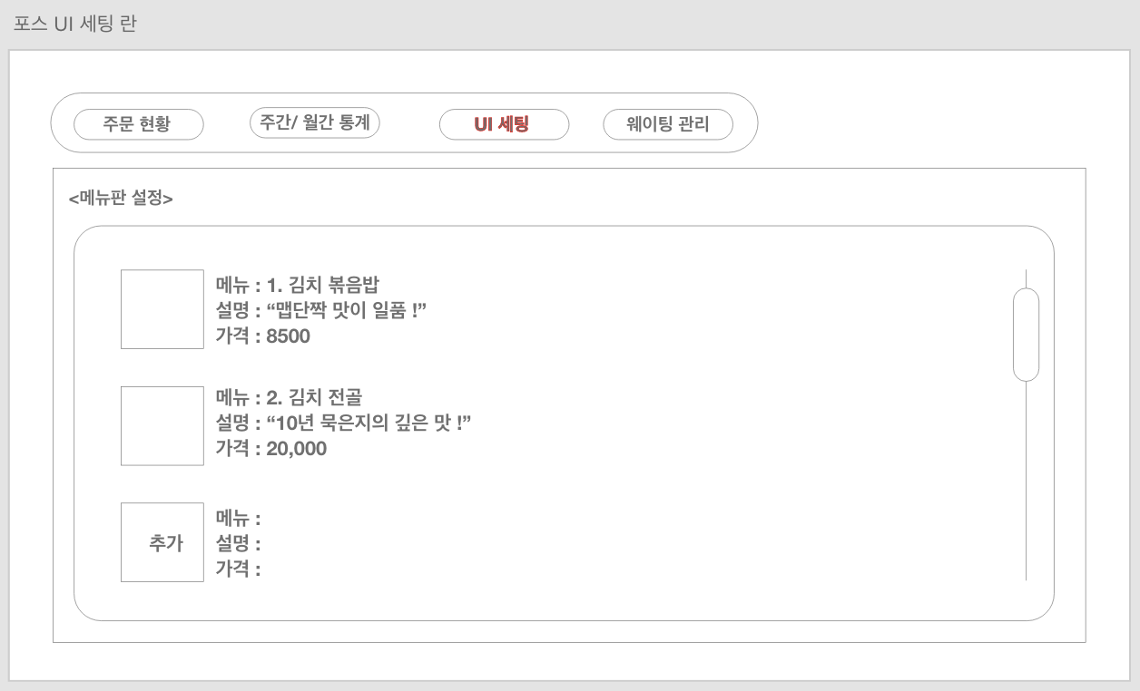
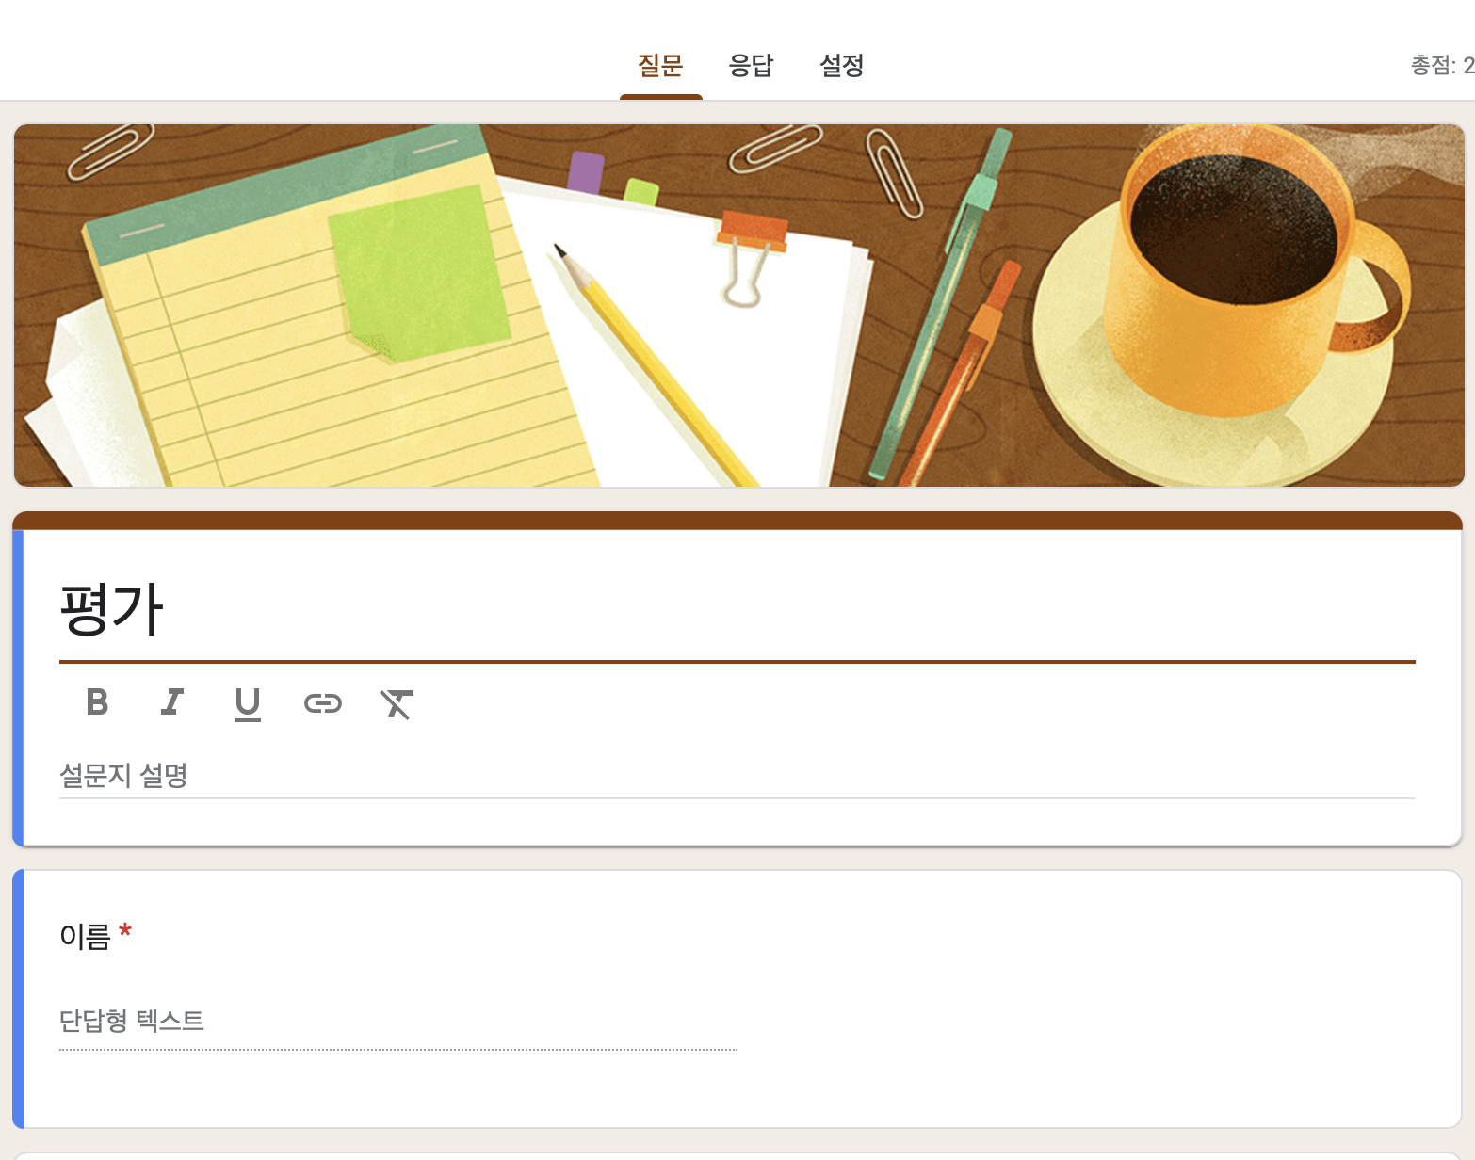
Process
Operator Process (Modify)

Slide 11
SWOT
Strength: low barriers to entry , employment cost
Weakness : Absence of payment service
Opportunity : high potential
Threat : low awareness

Slide 12
Study Plan
Front
1. Frame 2. Design
-> html, css, javascript -> UX/UI
-> React -> Xd, Figma
-> http, API, DB, RESTful API..
-> Learning Big Data

Slide 13
Study Plan
Back-end 1. Programming Language : Java & Spring 2. Design Pattern : MVC, Singleton ... 3. Web : HTTP, RESTful API, socket ... 4. DB: SQL, design pattern 5. Cloud : Docker, AWS ... 6. Front-end : http, css, javascript 7. API

Slide 14
Goal
Business infrastructure expansion + Utilize big data
Study To gain valuable experiance through cooperation between front-end and back-end developers.

